Slide 1
ADL Matrix
The ADL Matrix helps develop strategies that can be used to understand the competitive position of your products, services or business units in the market.
To effectively use this matrix, senior leaders need to consider: 1) the amount of competitive influence or market share the product, service or business unit has in the market, and 2) the maturity of the industry in which this specific unit is offered.
The various combinations of these two factors produce a matrix that will indicate where the company’s product, service or business unit portfolio sits within its external environment.
The ADL Matrix can be used as an initial step for executive decisions concerning how to hold or improve the company’s overall market position.
Want more best practices? Visit Praxie.com

Slide 2
ADL Matrix
List your organization’s offerings or business strategies in the relevant cells based on the current maturity level of the markets or industry within which you operate and your competitive position within the market or industry. Use the model to define your current state and/or your future state to inform your strategy.
Industry/Market Life Cycle Stage
 | Embryonic | Growth | Mature | Aging
Dominant | Hold Position and Push for Share – aim to maintain control by keeping other offerings/ competitors out while pushing for additional share | Hold or Improve Position and Share – aim to maintain competitiveness while pushing for additional share | Hold Position, Grow with Industry – maintain market share and grow with the market | Hold Position, Milk the Market – aim to maximize revenues and profits while holding market share
Strong | Improve Position and Push for Share – push to increase market share and strengthen your brand | Improve Position and Push for Share – attempt to grow market share while improving competitiveness | Hold Position, Grow with Industry – maintain market share and grow with the market | Hold Position or Harvest – hold market position while harvesting profits
Favorable | Selective Improve Position or Selective Push for Share – find ways to improve share or position, making bets on most impactful choices | Invest to Boost Position and Share – identify strategic game-changing investments or acquisitions that can dramatically improve position and share | Find Niche and Protect It – find a niche that can allow you to protect your position and grow within it | Harvest, Phased Out Abandon - manage costs, harvest profits and create a phased plan to leave the industry in the medium term
Tenable | Selective Push for Position – find ways to improve position, making bets on most impactful choices | Find Niche and Protect It – find a niche in which your business can survive and grow within it | Find Niche or Abandon Market – find a niche in the immediate to short term or prepare to withdraw from the industry | Phased Out Abandon Market – create a phased plan to withdraw from the industry in the short to medium term
Weak | Up or Out – find ways to make a dramatic improvement in position or leave the market | Turnaround or Abandon Market – define a plan to improve competitive position in the short to medium term or plan for withdrawal | Turnaround or Abandon Market – dramatically improve competitive position or plan for a quick withdrawal | Abandon Market – execute plan to leave market in the shortest term possible
Competitive Influence / Position
Want more best practices? Visit Praxie.com

Slide 3
ADL Matrix
List your organization’s offerings or business strategies in the relevant cells based on the current maturity level of the markets or industry within which you operate and your competitive position within the market or industry. Use the model to define your current state and/or your future state to inform your strategy.
Industry/Market Life Cycle Stage
 | Embryonic | Growth | Mature | Aging
Dominant | List your company’s product, services or business units for this quadrant
Strong | List your company’s product, services or business units for this quadrant
Favorable | List your company’s product, services or business units for this quadrant
Tenable | List your company’s product, services or business units for this quadrant
Weak | List your company’s product, services or business units for this quadrant
Competitive Influence / Position
Want more best practices? Visit Praxie.com

Slide 4
Actions
Create an action plan focused on building your ADL Matrix, gathering any relevant data, and analyzing results with your team or other stakeholders. Also list any actions based on the strategic implications the matrix holds for your strategy and implementation plans.
Actions | Owner | Due Date
Enter action here | Enter owner | Enter due date
Want more best practices? Visit Praxie.com

Slide 5
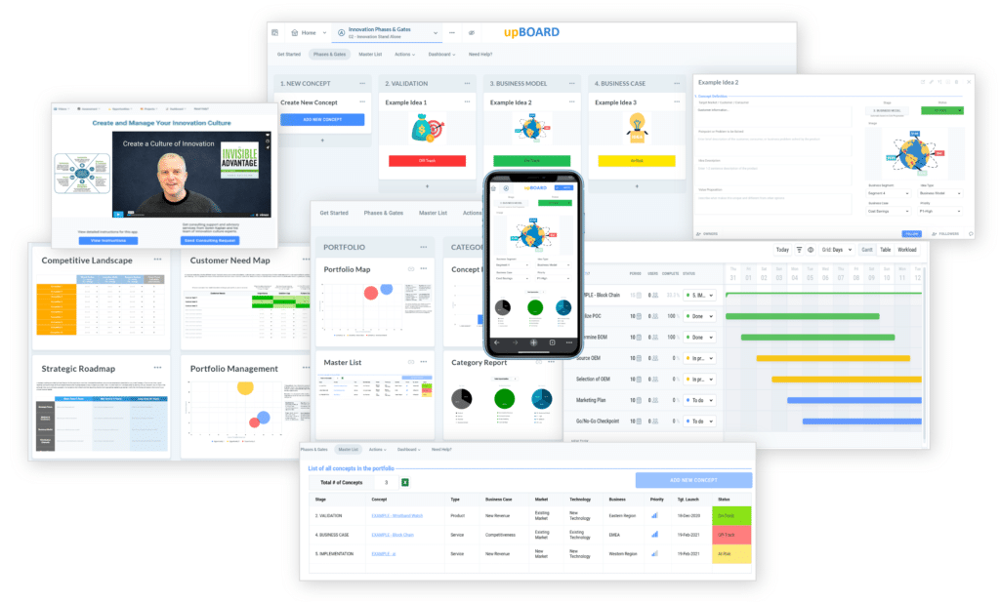

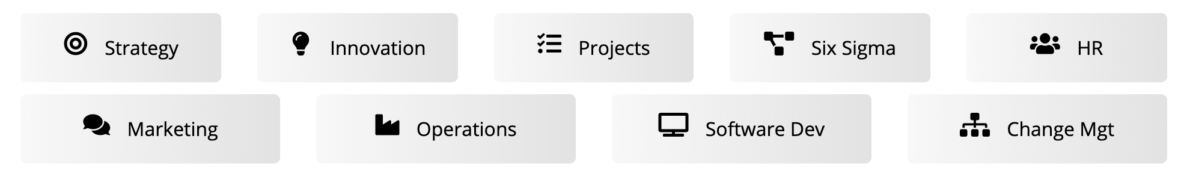
www.praxie.com
Learn, Configure & Run Business Best Practice Applications in Minutes.
Want more best practices? Visit Praxie.com

