Slide 1
Balanced Scorecard
The Balanced Scorecard is a strategic planning tool used ubiquitously in organizational management that clearly and concisely communicates what the organization has set out to achieve and how it proposes to do it.
The model summarizes an organization’s high-level strategic goals, initiatives designed to reach those goals, and metrics, or key performance indicators, that monitor success over time, and shows how they are connected to the mission, vision, and core values of the organization.
Want more best practices? Visit Praxie.com

Slide 2
Balanced Scorecard
For each dimension of the balanced scorecard, list your strategic goals, the initiatives that support the goals, the metrics that will be used to measure the success of the initiatives, and the target metrics that you will ideally achieve.
 | Strategic Goals | Initiatives | Metrics | Targets
Financial Sustainability | List strategic goals | List initiatives to support strategic goals | List metrics to measure initiatives | List target metrics to achieve
Customer Experience | List strategic goals | List initiatives to support strategic goals | List metrics to measure initiatives | List target metrics to achieve
Internal Processes & Structures | List strategic goals | List initiatives to support strategic goals | List metrics to measure initiatives | List target metrics to achieve
Learning | List strategic goals | List initiatives to support strategic goals | List metrics to measure initiatives | List target metrics to achieve
Want more best practices? Visit Praxie.com

Slide 3
Actions
Create an action plan based on creating your Balanced Scorecard, gathering input and creating alignment with your team, and implementing the Balanced Scorecard itself.
Actions | Owner | Due Date
Enter action here | Enter owner | Enter due date
Want more best practices? Visit Praxie.com

Slide 4
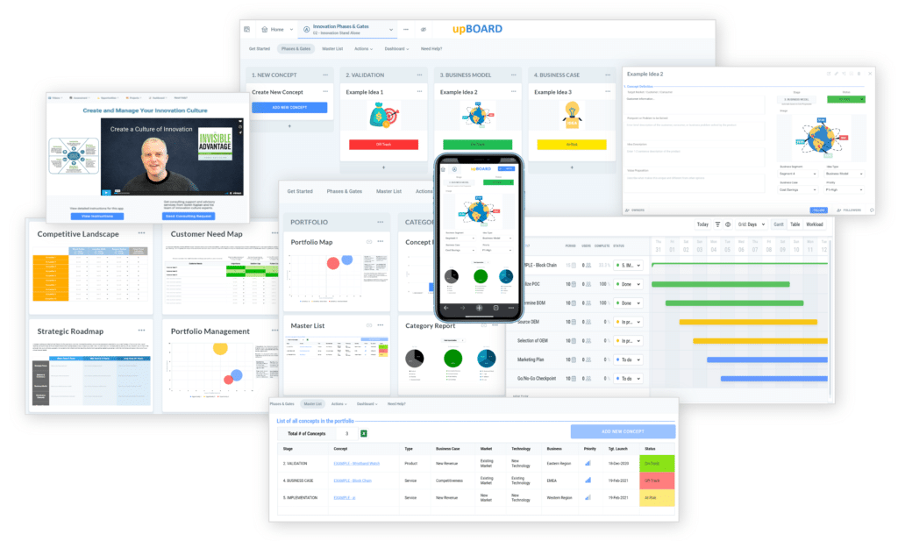

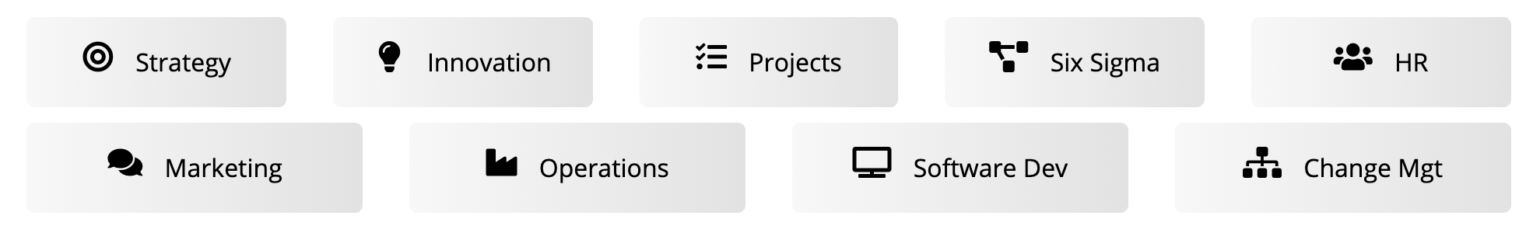
www.praxie.com
Learn, Configure & Run Business Best Practice Applications in Minutes.
Want more best practices? Visit Praxie.com

