Slide 1

Design Thinking
Toolkit
Everyone Can Innovate

Slide 2
Design Thinking Toolkit
This toolkit provides an opportunity to gain practical tools to help your organization transform and grow. With this toolkit, you will learn new ways to approach business problems, how to become comfortable with being uncomfortable, and all the benefits of design thinking.
Ground Rules:
1. Everyone can innovate
2. Be open to new possibilities
3. Be present
4. Everyone has an equal voice
5. Work as a team

Slide 3
Innovation Definition
Innovation is the act of creating new value for customers and the business.
We achieve this through:
Empowering open-minded, creative people
Agile collaboration and new approaches to work
Continuously improving existing processes, offerings, and customer experiences
Creating new products, services, and processes

Slide 4
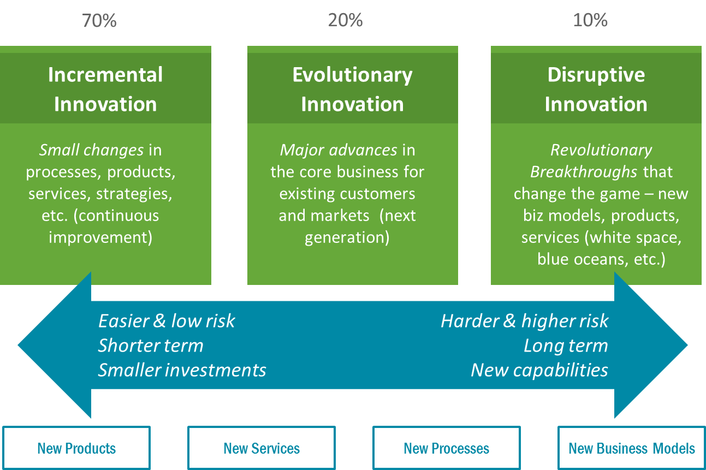
Three Types of Innovation
We’re interested in three types of innovation. This toolkit contains tools and approaches that will allow you to create and develop ideas focused on any level of innovation.

Slide 5

Defining the Customer Problem
It is critical to document the “customer problem” you want to tackle. Clearly articulating what you’re trying to solve, create, or do is the first essential step for innovation since it provides the focus for the ideas generated during the innovation process. A proper framing statement focused on your customer’s problem(s) will ensure ‘Applied Innovation’.
The easiest way to decide what to focus on for innovation is to write it out as a single question:
How might we… ?
Supporting bullets
A more detailed way to define the customer problem is by writing down a paragraph like this:
I am [customer - with 3 characteristics].
I’m trying to [outcome/job], but [problem/barrier] because [root cause], which makes me feel [emotion].

Slide 6
Customer Problem
Examples
Question:
How might we significantly increase customer satisfaction?
In ways that can dramatically reduce support call costs
To increase end-customer’s positive sentiment for our company
Paragraph:
I am an internal business partner in the finance department.
I’m trying to generate the monthly business review, but it takes me a long time to get the financial reports because creating reports requires specialized analytic skills and I can’t easily generate them myself, which makes me feel stressed, out of control, pressed for time, and frustrated.

Slide 7



Applied Innovation Process
The innovation process has two phases – Divergence & Convergence.
While this approach may appear linear, there is naturally a great deal of iteration throughout both phases.
The Divergent phase is a time for gathering insight into unmet needs, identifying problems to work on, and thinking imaginatively about a range of solutions.
The Convergent phase involves selecting the best idea, testing it, learning what works, modifying the solution accordingly, and then taking action.
Empathize
Ideate
Prioritize
Experiment
Gain customer insight & reveal new opportunities
Focus on idea generation, going broad & wide
Assess ideas, going narrow & specific
Prototype the idea: test, learn, and refine

Slide 8
Tools & Methods
Included in this toolkit, under each of the four phases, are specific tools to help you get started. You can use them on your own, with a partner, or in small teams.
◦ Insights Safari
Empathize
◦ Brainstorming
Ideate
◦ Prioritization
Prioritize
◦ Rapid Prototyping
Experiment

Slide 9
When To Use It
Insights Safari
Empathize
Gaining customer insights to reveal new opportunities
Why Use It
Insights Safari is used to develop empathy and obtain insights directly from existing, new or prospective customers. “Customers” should be defined broadly to include external and internal customers (e.g., other business functions that you serve).
The goal is to surface specific needs, pain points, desires, motivations, frustrations and workarounds to help fuel new ideas.
By taking the time to ‘walk in others’ shoes’ we can find inspiration for new ideas that solve real problems or address unmet needs.
Identifying, validating or modifying the customer problem
Understanding current solutions in the customer’s context
Identifying opportunities to improve or change the customer experience, products, services, or processes
Identifying issues, artifacts or environmental factors that influence your customers
Approach
GET ORGANIZED: Create your plan by considering:
Objectives: What do you want to learn about? What do you want to observe customers actually doing?
Who: What kinds of customers do you want to engage (e.g., demographics, lifestyle, usage habits – or internal teams, tenure in role)?
Where: Where should you conduct these visits (e.g., in office, homes)?
How: What approaches do you want to take (e.g., observation, in-depth interviews, respondent journaling or drawing, word associations, prototype evaluations)?
Process: How will you capture observations (e.g., take notes, photos, videos, sketches)?
Roles: Assign individual responsibilities (e.g., create a few discussion questions, set up/schedule the visits, manage logistics, lead the debrief/synthesis of the outputs).
VISIT, OBSERVE AND RECORD: Be prepared with an informal Interview Guide containing 8 – 10 key questions you’d like to ask during the visits. Observe and interact with customers, capturing notes and ideas, using the “What, So What” template.
CREATE A “WHAT, SO WHAT” CHART: Review and debrief what you observed (the ‘What’) – and what ideas/opportunities present themselves as a result (the ‘So What’?). Capture the key points of your discussion on a flip chart (using the “What, So What” template below). Use this written documentation as input to the brainstorming process.
Tips
Seek insights: a deep understanding of a person is the starting point for innovation (pain points, needs, desires, workarounds…)
Assume a beginner’s mindset and put aside any biases
Print copies of the “What, So What” template and take notes on it
Take photos/videos of the customer or environment to capture insights or share with others who were not able to participate

Slide 10
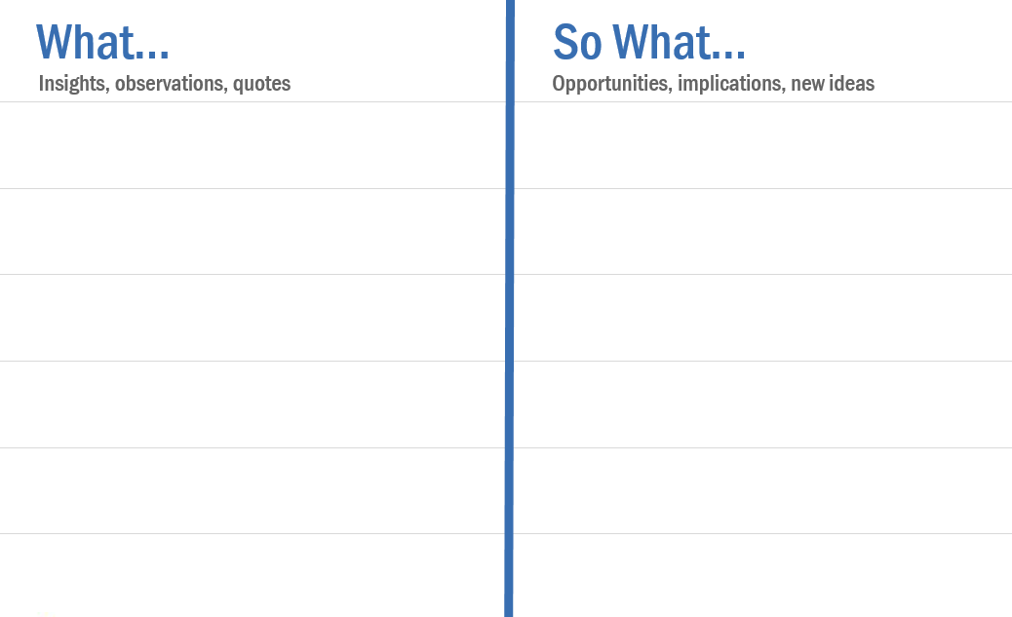
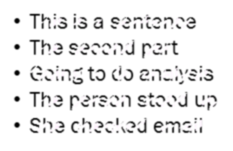
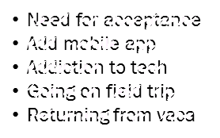
Overview
Visit, observe and record
Create a “What, So What” chart
Get organized
What are you trying to do?

Slide 11
When To Use It
Brainstorming
Ideate
Focusing on idea generation by going broad & wide
Why Use It
Brainstorming helps you generate many creative ideas and options.
This is a key step in the early stage of the innovation process – and the intent is to produce a large number of ‘seed ideas’ through a freewheeling, creative process leveraging the collective thinking of a group.
During the latter stages of the innovation process, you will prioritize and filter these ideas so you can focus on the one(s) that are most promising.
Generating many new ideas quickly
Incorporating diverse perspectives
Probing more deeply into a problem or opportunity area
Approach
PICK A GREAT TEAM by engaging a diverse set of 6-12 people from various functions – they’ll bring a mix of necessary expertise and will look at the world in different ways from each other.
FIND AN INSPIRING SPACE by choosing an area that’s pleasant and easy to move around in (e.g., natural light, spacious), and has plenty of wall space for posting your ideas.
PROVIDE INSIGHT AND INSPIRATION by giving all participants some sort of ‘innovation assignment’ before the meeting to provide them context, to spur their creative thinking, and to put them in the right frame of mind.
SET CONTEXT by grounding participants in the problem or opportunity space, project history, personas and insights. If some people went through an Insights Safari, share the ‘What, So What’ notes with the rest of the team.
FOCUS ATTENTION by writing the customer problem or a provocative question on the board (How might we…? or What ways can…?).
QUIET IDEATION to balance different thinking styles. Spend two to three minutes capturing ideas individually. Each idea should be captured separately on its own 8½" X 11" sheet of paper.
ENGAGE EACH PARTICIPANT by asking them to share an idea.
REINFORCE the idea by repeating and clarifying it, and then sticking it on the board or wall.
IDEATE MORE AND BUILD on the existing ideas. ‘Builds’ should be captured on 3"x 5" Post-Its and stuck onto the idea’s sheet of paper to which it refers.
CLUSTER ideas into themes, then move to the Prioritization step.
Tips
If time is tight, cluster ideas on the fly by prompting the group for any related ideas
To generate more ideas add or remove constraints, for example, ask “what if we had a million dollars”, followed by “what if we had $5”
Push new thinking: combine 2 or 3 ideas in different ways to generate new ones, bring ‘Innovation Analogs’ or use ‘SCAMPER'

Slide 12
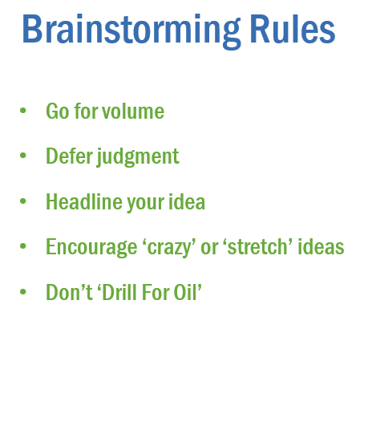
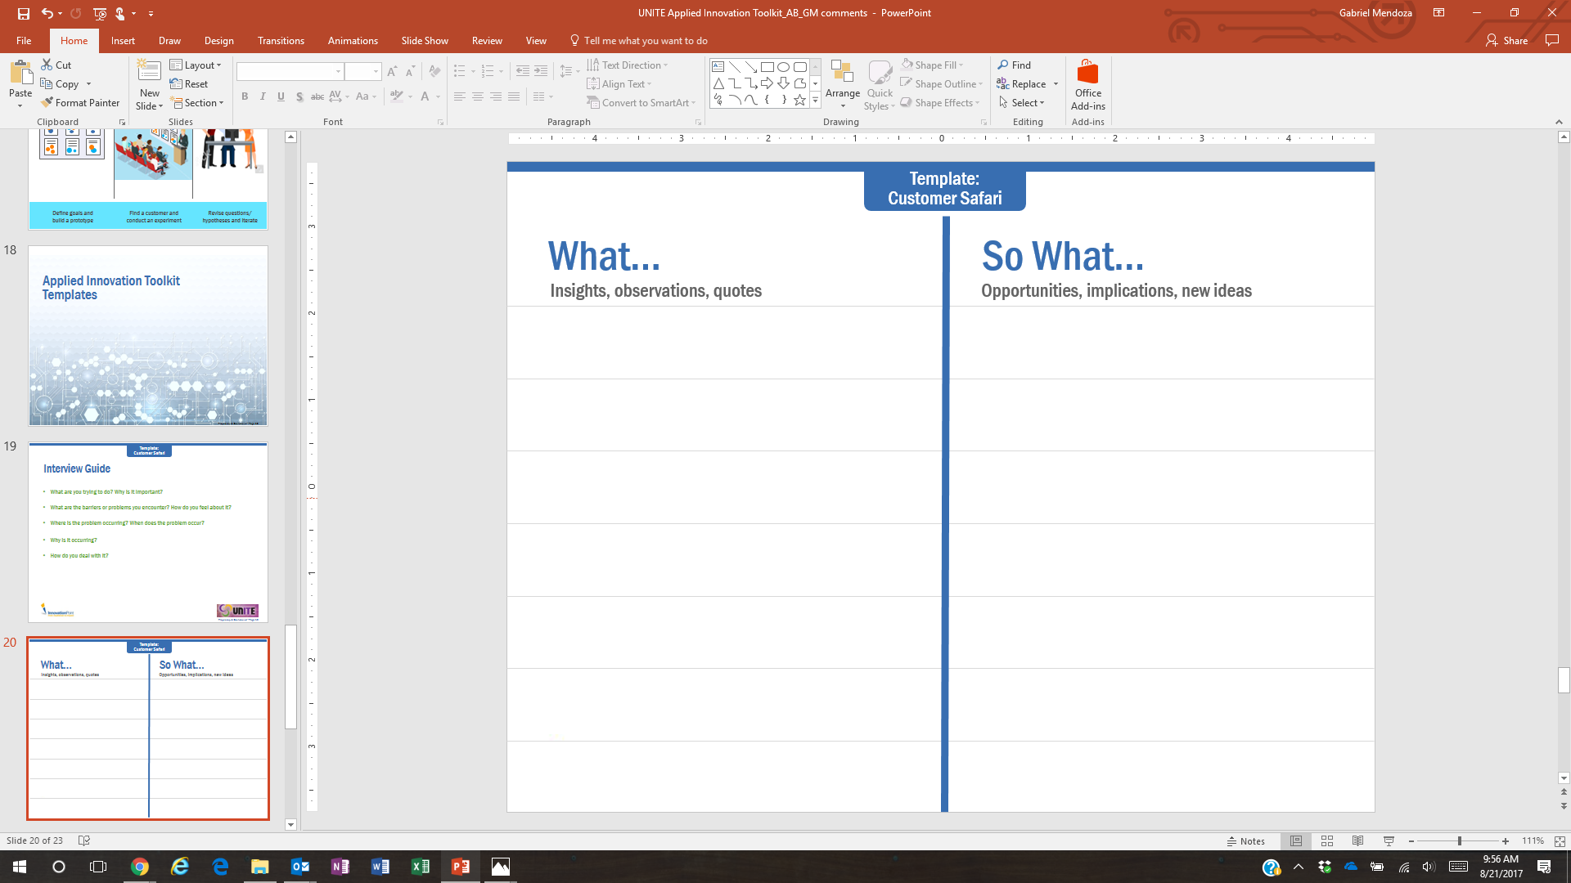



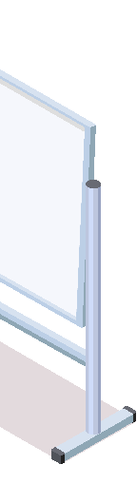

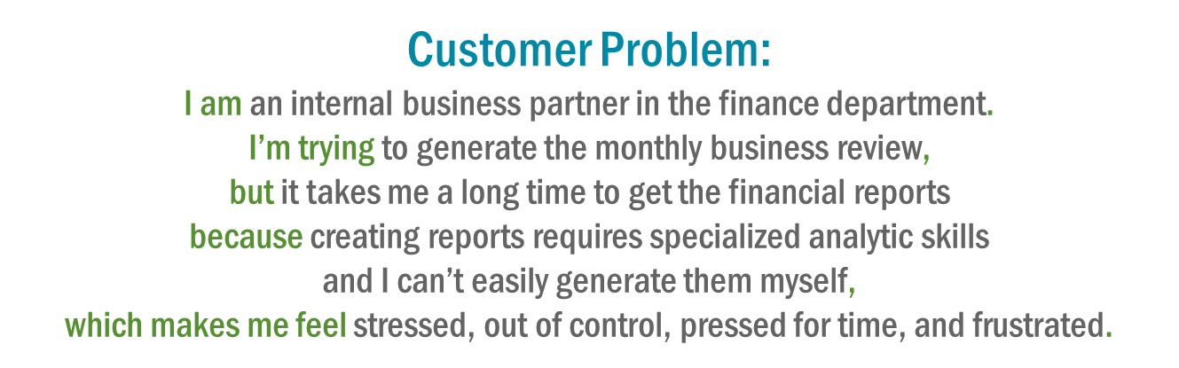



Overview
Choose a great team, an inspiring space, and provide context
Capture ideas individually, then share ideas and generate more as a group
Review, “build” on ideas, and cluster into themes
How might we…?
Idea 1 Headline
Idea 2 Headline
Idea 3 Headline
Builds

Slide 13
When To Use It
Prioritization
Prioritize
Assessing ideas by going narrow & specific
Why Use It
After your brainstorming session you will have a lot of “seed ideas”. The next step is to cluster them all into themes, remove duplicates, and prioritize them.
Prioritization usually happens immediately following the brainstorming session. This can be done as part of the brainstorming session itself, or shortly thereafter. To maintain continuity, try to work with the same individuals who created the ideas in the brainstorming session.
Prioritization is the first step in “turning the corner” in the innovation process since it involves selecting one or more concrete ideas to pursue.
Comparing different ideas across a common set of principles or criteria
Uncovering the team’s natural energy for specific ideas, tapping on their collective experiences and knowledge
Identifying which ideas to select for further development
Approach
DEFINE THE EVALUATION CRITERIA: Create a set of selection criteria by which to evaluate the ideas. A set of 2–3 criteria is recommended. Common examples include strategic fit, customer value, ROI, ‘WOW’ factor, feasibility… etc. Once the criteria have been agreed upon, write them up on a flip chart in the front of the room.
REVIEW IDEAS: Do a ‘wall walk’ and review all the available ideas. If the ideas came from a brainstorming session, review the already grouped/clustered ideas. Review every idea to make sure everyone understands them.
INDIVIDUAL EVALUATION OF IDEAS: Ask everyone to use a notepad during the review process to write down their votes for their top ideas. This approach eliminates the possibility of “group think.” After everyone has written down their top ideas, then go to the next step.
VOTE FOR BEST IDEAS: Hand everyone a set of colored dots. Ask everyone to place a single dot on each of their priority ideas (depending on the number of ideas, ask each person to select their top 5-7-10 ideas). A general rule of thumb is to use N/5 rule – this means each person receives 1 vote for every 5 ideas in the room.
REVIEW AND FINALIZE: When everyone has voted, it should quickly become apparent which ideas the group sees as the top priorities. Briefly discuss the results, noting anything that’s surprising or has been missed. Capture the top ideas on a flip chart as a Master List, noting the number of votes each one received. Select your top idea(s) to carry forward into the Experimentation step.
Tips
In the voting step, instruct people to place a single dot on a single idea, not to put multiple dots onto an idea that they really like.
After completing the prioritization process, be sure to capture all ideas (not just the leading ideas) as a bulleted list in a simple Word or Excel document. All ideas are worth preserving as they may be used in future work.

Slide 14
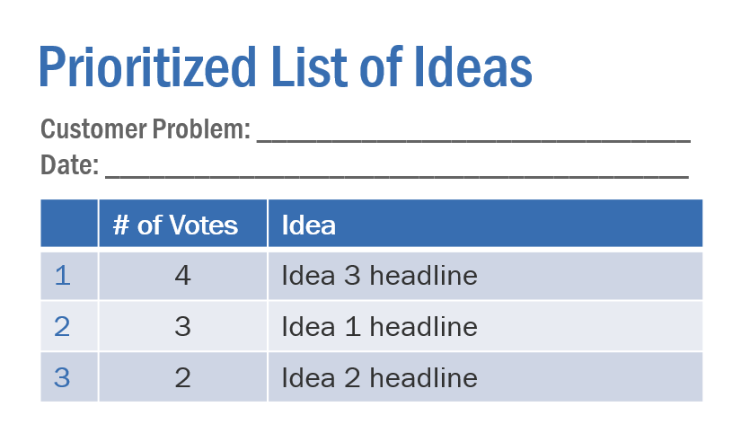
Overview
Define selection criteria and review ideas
Individually evaluate ideas and vote for the best ones
Document prioritized list of ideas, review and finalize
Idea 1 Headline
Idea 2 Headline
Idea 3 Headline
Selection Criteria
Strategic fit
Customer value
ROI
‘WOW’ factor
Feasibility

Slide 15
When To Use It
Rapid Prototyping
Experiment
Prototyping the idea by testing, learning, and refining
Why Use It
Rapid prototyping is applied after you have a relatively concrete idea and you’re ready to test it, learn from what you find, and then refine it.
The approach involves conducting quick “experiments” – so you can “learn fast and fail cheap.” This is done by creating a very simple “prototype” and gathering input from customers or peers.
Prototypes can be literally anything, from a PowerPoint slide to a diagram or sketch done by hand. They can also include more robust technical mockups of websites or apps, but what’s important is to create something quickly. It’s all about learning and iterating as fast as possible.
Learning cheaply and quickly; gathering feedback on ideas so they can be improved in a short period of time
Testing a concept or idea by showing ‘something’ to customers for immediate feedback, minimizing arguing time between the team
Finding a concept that you know hits the mark, solves a real problem, or meets a concrete need
Approach
DEFINE WHAT YOU WANT TO LEARN: Write down your key questions, assumptions, or hypotheses around the idea and determine which one(s) you want to validate (or invalidate) first. What do you hope to test with the user? What sorts of behavior do you expect?
BUILD A PROTOTYPE: Define a real-life scenario storyboard (see template) that probes your key questions or hypotheses. Create low-resolution objects (e.g. slide, sketch, wireframe…). Staying low-res allows you to pursue many different ideas you generated without committing to a direction too early on. The objective is not simply to create a mock-up or scale model of your solution concept; it is to create experiences to which users can react.
FIND A ‘CUSTOMER’: Customers could be internal or external people that have experience with the customer problem you’re aiming to solve. The goal is to get quick feedback from anyone with a relevant perspective – not to conduct painstaking research!
CONDUCT EXPERIMENT: Present your prototype to your target customer(s) or test it out in whatever way will give you the quickest, most useful feedback. Ask questions like: what do you like the most/least about the idea? Why? What works/doesn’t work about this idea? How could we make this idea better?
REVISE QUESTIONS/HYPOTHESIS: Once you’ve obtained sufficient feedback from round one, go back and update your idea and answer the questions that the experiment was able to answer. The goal is to take the most meaningful inputs and incorporate them into the idea. If you received negative feedback, ‘pivot’ the concept toward the direction that the customer provided and try another experiment after adjusting the prototype.
ITERATE: The number of iterations required (and the degree of change from the original idea) can vary wildly. When you feel you have learned what you need to, and have iterated enough, you should update your prototype one final time.
Tips
Keep an open mind. Don’t get too attached to any particular prototype, mock-up, or design because it will change for sure
When you share the idea with customers, share the situation and let them interact with the prototype and ask for honest feedback
‘Concept Writing’ can be used before physical prototyping to further elaborate on the ideas; after validation, it’s recommended to design a ‘Business Canvas’ for the most promising concepts

Slide 16
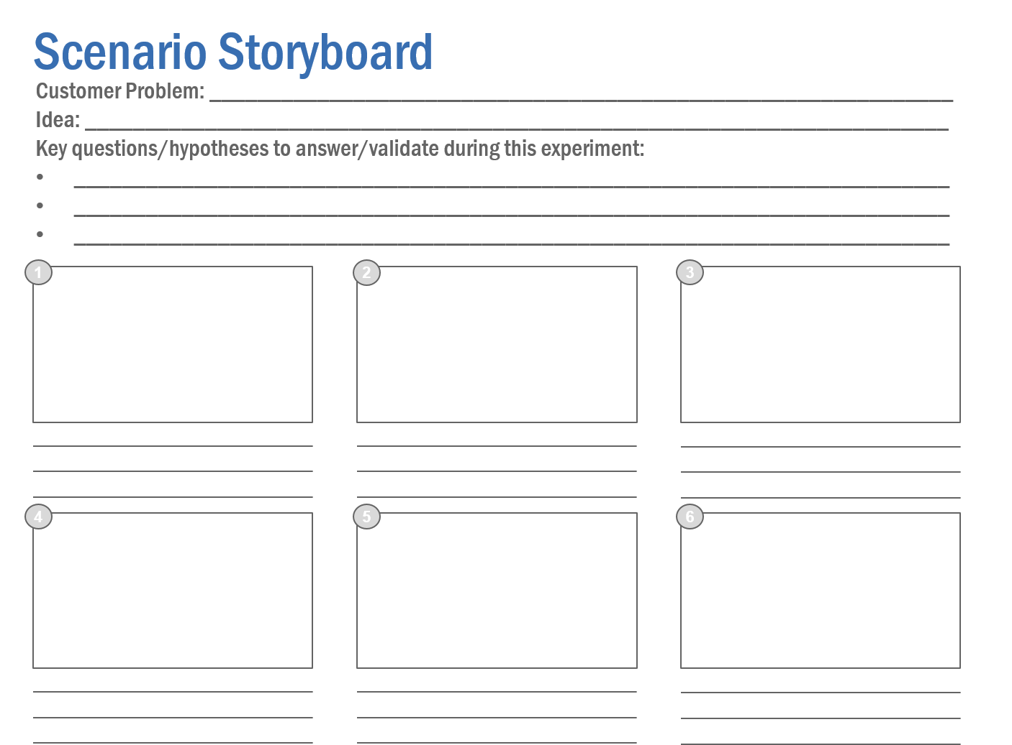

Overview
Define goals and build a prototype
Find a “customer” and conduct an experiment
Revise hypotheses and iterate until you have learned what you need to
How can we make this idea better?

Slide 17
Design Thinking Toolkit Templates

Slide 18
Templates
Included in this toolkit, under each of the four phases, are specific templates to help you get started. You can use them on your own, with a partner, or in small teams.
◦ Plan Guide
◦ Interview Guide
◦ What… So What…
Empathize
◦ Brainstorming Room Setup & Materials ◦ Brainstorming Rules
◦ Innovation Analogs
◦ SCAMPER
Ideate
◦ Criteria for Prioritization
◦ Prioritized List of Ideas
Prioritize
◦ Concept Writing
◦ Scenario Storyboard
◦ Smartphone Template for Prototyping
◦ Business Model Canvas
Experiment

Slide 19
Plan Guide
Template: Customer Safari
Objectives: What do you want to learn about? What do you want to observe customers actually doing?
Who: What kinds of customers do you want to engage (e.g., demographics, lifestyle, usage habits – or internal teams, tenure in role)?
Where: Where should you conduct these visits (e.g., in office, homes)?
How: What approaches do you want to take (e.g. in-depth interviews)?
Process: How will you capture observations (e.g., take notes, templates)?
Roles: Assign individual responsibilities (e.g., review interview questions, note takers).

Slide 20
Interview Guide
Template: Customer Safari
What are you trying to do? Why is it important?
What are the barriers or problems you encounter? How do you feel about it?
Where is the problem occurring? When does the problem occur?
Why is it occurring?
How do you deal with it?
If you had a magic wand, what would you change or create as an ideal scenario?

Slide 21
What… So What…
Template: Customer Safari
Insights, observations, quotes
Opportunities, implications, new ideas

Slide 22
Brainstorming Room Setup and Materials
Template: Brainstorming
Room Setup
Materials Needed
Flip charts with markers
Sharpies (enough for each participant)
Ream of 8.5 x 11 white paper
Ream of 8.5 x 11 colored paper
3 x 5 colored Post-it notes
Colored voting dots
Painter’s Tape
Screen
Facilitator Flip Chart
Small table with electrical & projector, audio input
Flip Chart
Flip Chart
Wall space for Brainstorm/Prioritize session
Wall space for Brainstorm/Prioritize session
Flip Chart
Flip Chart
Facilitator
Table
Supplies Table

Slide 23
Brainstorming Rules
Template: Brainstorming
Go for volume Keep up the pace and generate as many ideas as you can regardless of what you might initially think about the ‘quality’ of the ideas. Remember: “The best way to have a good idea is to have a lot of ideas.” – Dr. Linus Pauling
Defer judgment Remember that this is the stage in which all ideas are captured and not yet evaluated.
Headline your idea Express ideas in a few words, as a brief “soundbite”, and then move on quickly to the next idea. This makes the idea easy for everyone to understand and easy for the scribe to capture. It also makes the session very time efficient.
Encourage ‘crazy’ or ‘stretch’ ideas Give people permission to challenge assumptions and to come up with ideas that are off-the-wall or not feasible. It’s better to try to build feasibility into a crazy idea than the other way around.
Don’t ‘Drill For Oil’ Resist the temptation to start focusing on and fleshing out individual ideas in detail at this stage.

Slide 24
Innovation Analogs
Template: Brainstorming
How would these companies address or solve the customer problem?
eBay FedEx Hershey Whole Foods Apple Goodyear Dell Supercuts Rotten Tomatoes Facebook Chanel Uber | Mayo Clinic Six Flags Banana Republic Dr. Scholl’s Solomon Ski Pfizer Home Depot Target United Airlines Disney McDonald’s Pottery Barn | Skype Whirlpool Samsonite Lego Winnebago Harrah’s Cirque du Soleil Mattel Britney Spears Oprah Winfrey Google Comcast
Brainstorm additional companies and don’t be limited by these!

Slide 25
SCAMPER
Template: Brainstorming
S = Substitute | Use different processes, components, elements, information, etc. as a substitute for what currently exists. What could replace what’s there to vastly improve it?
C = Combine | Combine what exists with other processes, components, information, products, etc. to create something that’s better because it’s bundled or integrated. Could it be made part of a bigger solution?
A = Adapt | Alter or change its function. What can be modified and used in a different way?
M = Magnify | Increase or reduce what exists, or the attributes of what exists, in its overall scale and scope. What happens if you dramatically increase its size, shape, tone, frequency, height, etc.?
P = Put to Other Uses | Use what exists as something for which it wasn’t originally intended. What else can it be used for?
E = Eliminate | Eliminate features or attributes in ways that make it simpler, less complex, smaller, lighter, etc. What can you remove that actually improves things?
R = Reverse | Reverse the order of things or put things in a different sequence. How can you move things around to add value or create improvements?

Slide 26
Criteria for Prioritization
Template: Prioritization
Strategic Fit: level of fit with corporate vision and growth strategy
Customer Value: level of value that adds to the customer/solves the customer problem
Revenue or ROI: potential revenue for the company/return on investment
‘WOW’ Factor: potential for generating positive surprise or emotion to customers ‘Wow!’
Feasibility: level of confidence to develop this solution

Slide 27
Prioritized List of Ideas
Template: Prioritization
Customer Problem: _________________________________________________________
Date: _________________
 | # of Votes | Idea
1
2
3
4
5
6
7
8
9
10
…
N

Slide 28
Concept Writing
Template: Rapid Prototyping
Concept Name
Description (Brief 3-5 bullet point description of product, service, process, or experience, including what it is, how it’s used, or how it works)
Problems & Needs (Bullet point list of the 2-3 problems that the idea solves or the unmet needs it addresses)
Benefit Statement (Pithy one-line summary of the most important customer, member, club, or organizational benefit. What’s the ultimate benefit of this idea?)
Insights (List of the key customer, member, club, or other insights that underlie and support the idea. How do you know that it is of real value?)
Resource Requirements (General assessment of what may be needed to implement the idea in its full form. Consider people, money, and time)
Capabilities (List of existing processes, technologies, or other assets that can be applied for this idea)
Risk Factors (List of 2-3 risks involved in implementing the idea. What could be the biggest barriers or stumbling blocks?)
Gaps (List of top 2-3 key knowledge or information gaps about the idea. What else must be obtained or learned?)
Other Notes

Slide 29
Scenario Storyboard
Template: Rapid Prototyping
Customer Problem: ______________________________________________________________
Idea: ________________________________________________________________________
Key questions/hypotheses to answer/validate during this experiment:
_________________________________________________________________________
_________________________________________________________________________
_________________________________________________________________________
1
2
3
4
5
6

Slide 30

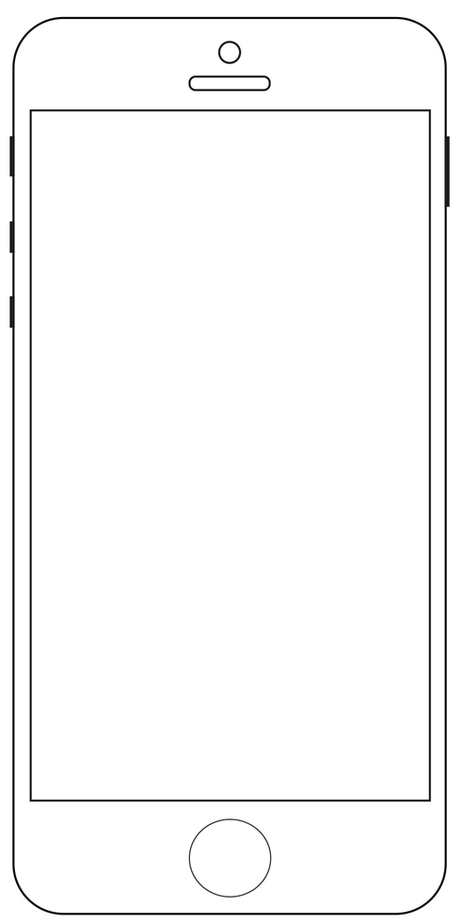
Template: Rapid Prototyping

Slide 31
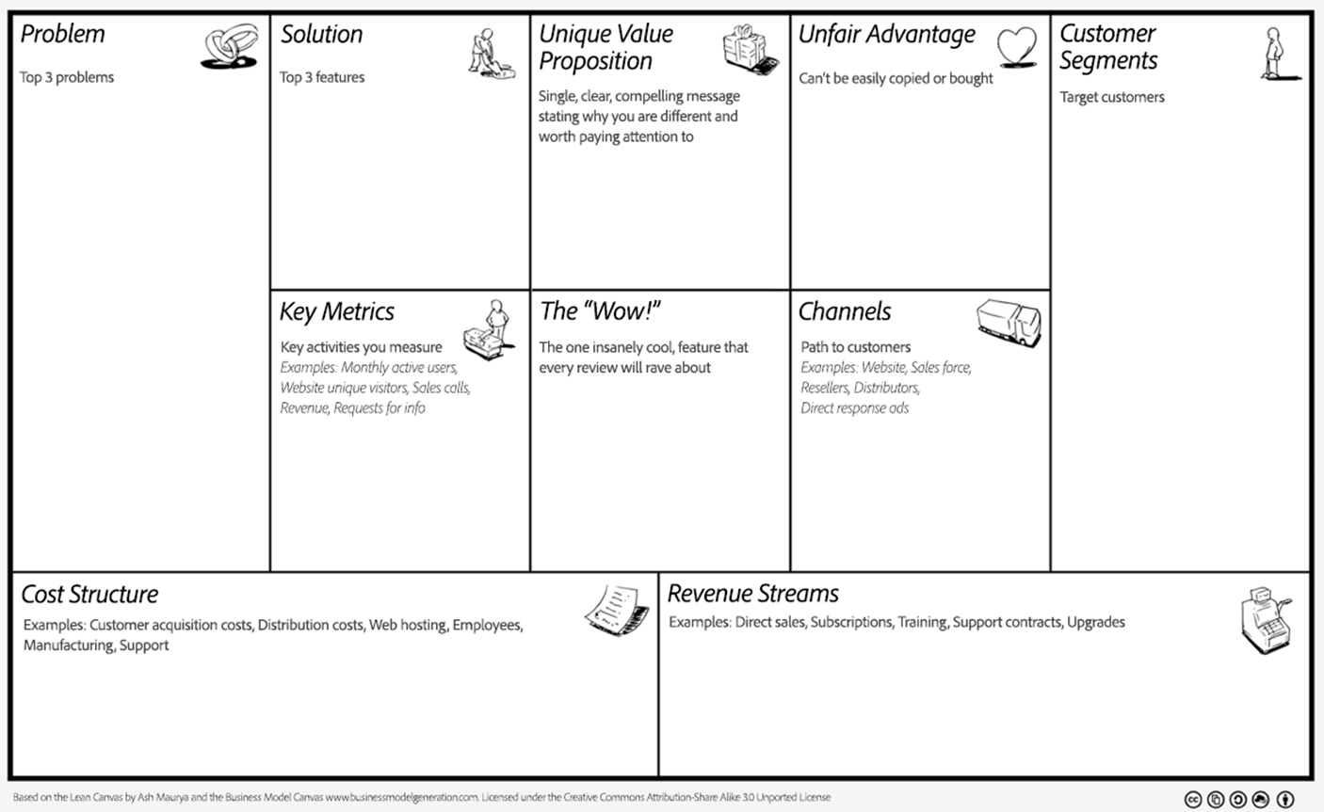
Business Model Canvas
Template: Beyond Rapid Prototyping
Source: Adobe. Based on the Lean Canvas by Ash Maurya and the Business Model Canvas. www.businessmodelgeneration.com. Licensed under the Creative Commons Attribution-Share Alike 3.0 Unported License

Slide 32
Design Thinking
Toolkit

